Slide 1




Federated Learning Based Cyber Hygiene Browser Extension
Presented By
Aadhaar Koul (Team Leader)
2020a1r040 , A1 ,7TH Semester

Slide 2
Contents
Problem Description
Global Landscape
Proposed Solution
Technical Stack
Framework
Workflow
Product / Modules
Demonstration

Slide 3
Problem Description
Cyber-crime now a days is booming at an alarming rate. The naiveness and the lack of awareness among the users has increased the rate of cyber-crime by a large number. The most common attacks to which the users are most susceptible are the phishing and the MITM(Man In The Middle Attacks) that are usually carried out on the free public WIFI's and home gateways. An estimate of about 10.5 Trillion Dollars is the round figure that cyber frauds are going to cost the world in the coming years.
Problem 1
People don't really care about their online activities and the cyber-crimes until they encounter one.
Problem 2
Industry grade software solutions are good but cost a lot and are very complex to implement.
Problem 3
There are different types of cyber-attacks and physical intrusions but no one stop solution currently available.

Slide 4
Solution 1
An AI based agent that deeply classifies the web urls and classifies them for a user level security advisory system.
Solution 2
A Global Sandboxed Environment to check for malformed or malicious data propagation.
Solution
Solution 3
A feedback mechanism which helps improve accuracy and effectiveness of the advisories , issued by the AI based agent on individual computers , against new emerging threats.
One Stop Cyber Security Solution
Solution 4
An advisory/recommendation system for the genuine web portal / sources for downloading commonly-used software/content

Slide 5













TECH STACK
Framework
Ai / ML
Frontend / Interface
Backend
Cloud
Hosting
Supporting Environments

Slide 6
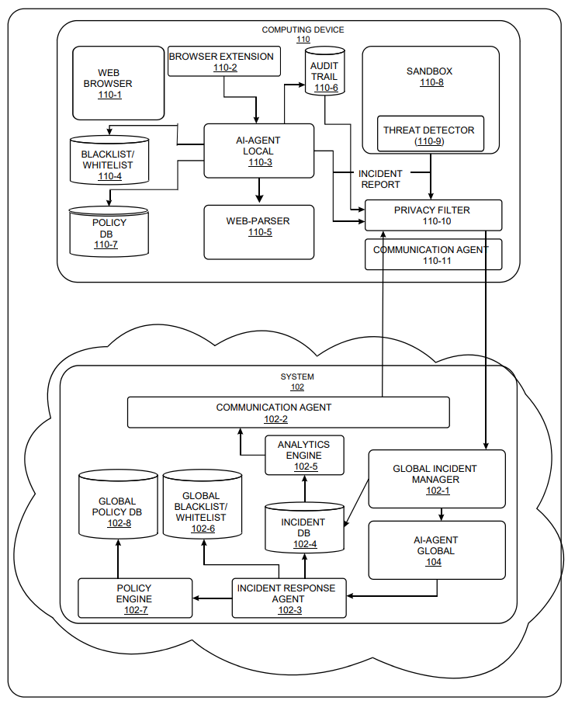
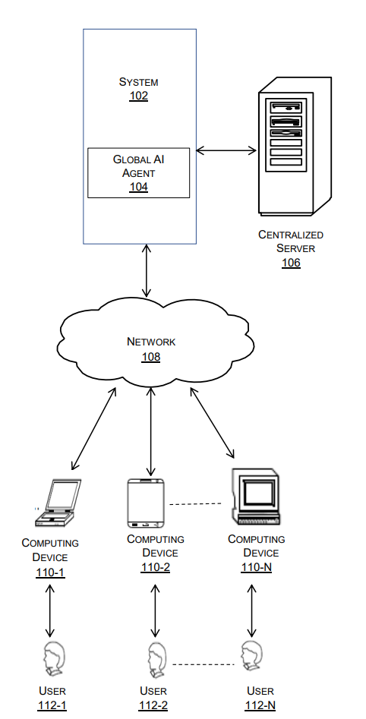

ARCHITECTURE

Slide 7
WORKFLOW
User generates web Request
Block Site
Tables and databases
Updated
All captured urls are parsed into a filter and are broken down into Domain , Sub domain , protocol , request code on the user’s local machine.
Alert messages are generated.
Malicious / Blacklisted Url
YES
Unsuccessful
Make an Incident Report and Send to the global AI
Force Disable JavaScript
Allow Site
CODE 200
YES
NO
Successful
Tables and databases
Updated
NO
Local AI Model
All Systems lockdown,
Site Blacklisted
Alerting and Advisory messaging system
Global AI Model

Slide 8
PROJECT MODULES
Message Alerting System
URL Parser
URL GUI Table
Local AI Model
Global AI Model

Slide 9
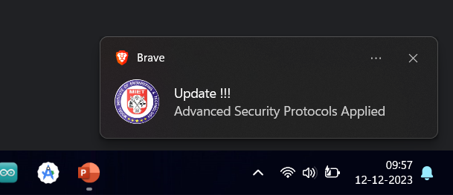
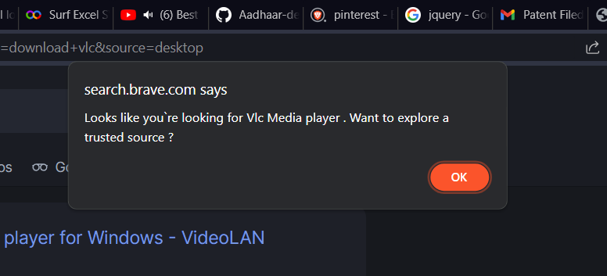
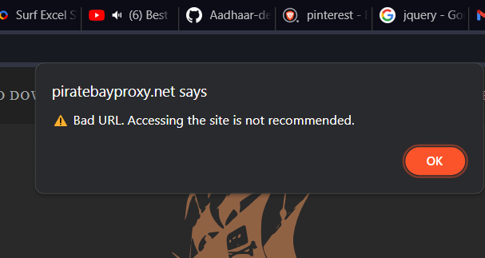
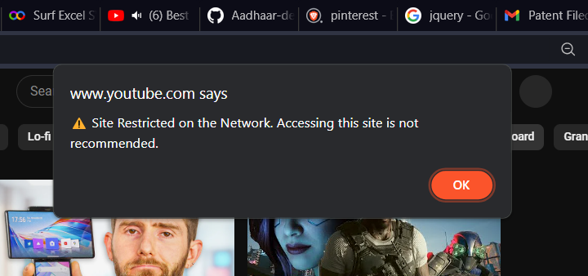
MESSAGE ALERTING SYSTEM
FEATURES
AI Generated personalized Alerting System.
Deployable on more than 14 web Browsers including , Chrome , Edge , Presearch , TOR etc.
Safety from untrusted software sources.
URL parsing transparency using a GUI interface.
Local Report and data dump functionality.
Seamless Coordination with local and global AI
TECHNOLOGY USED

Slide 10
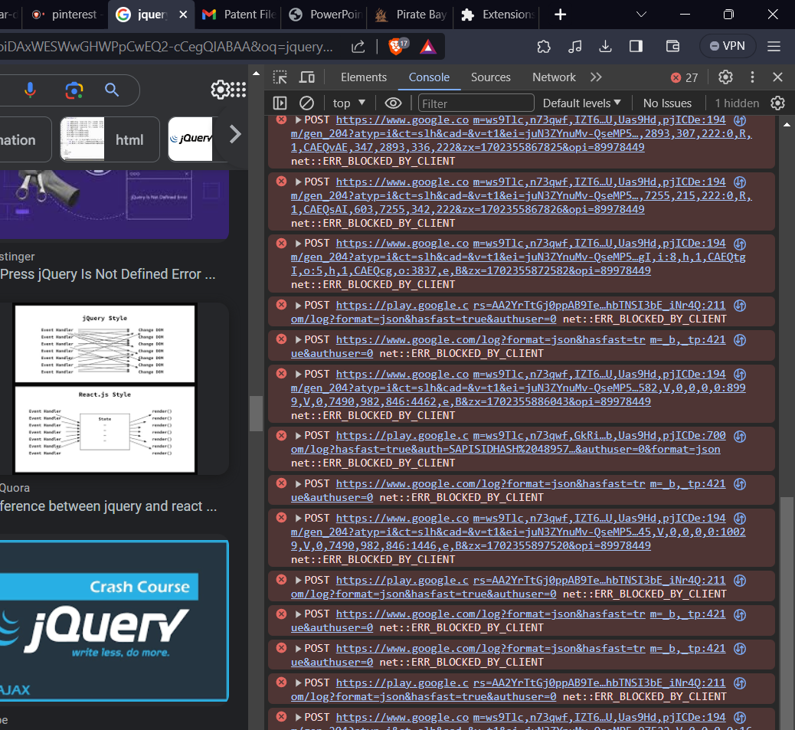
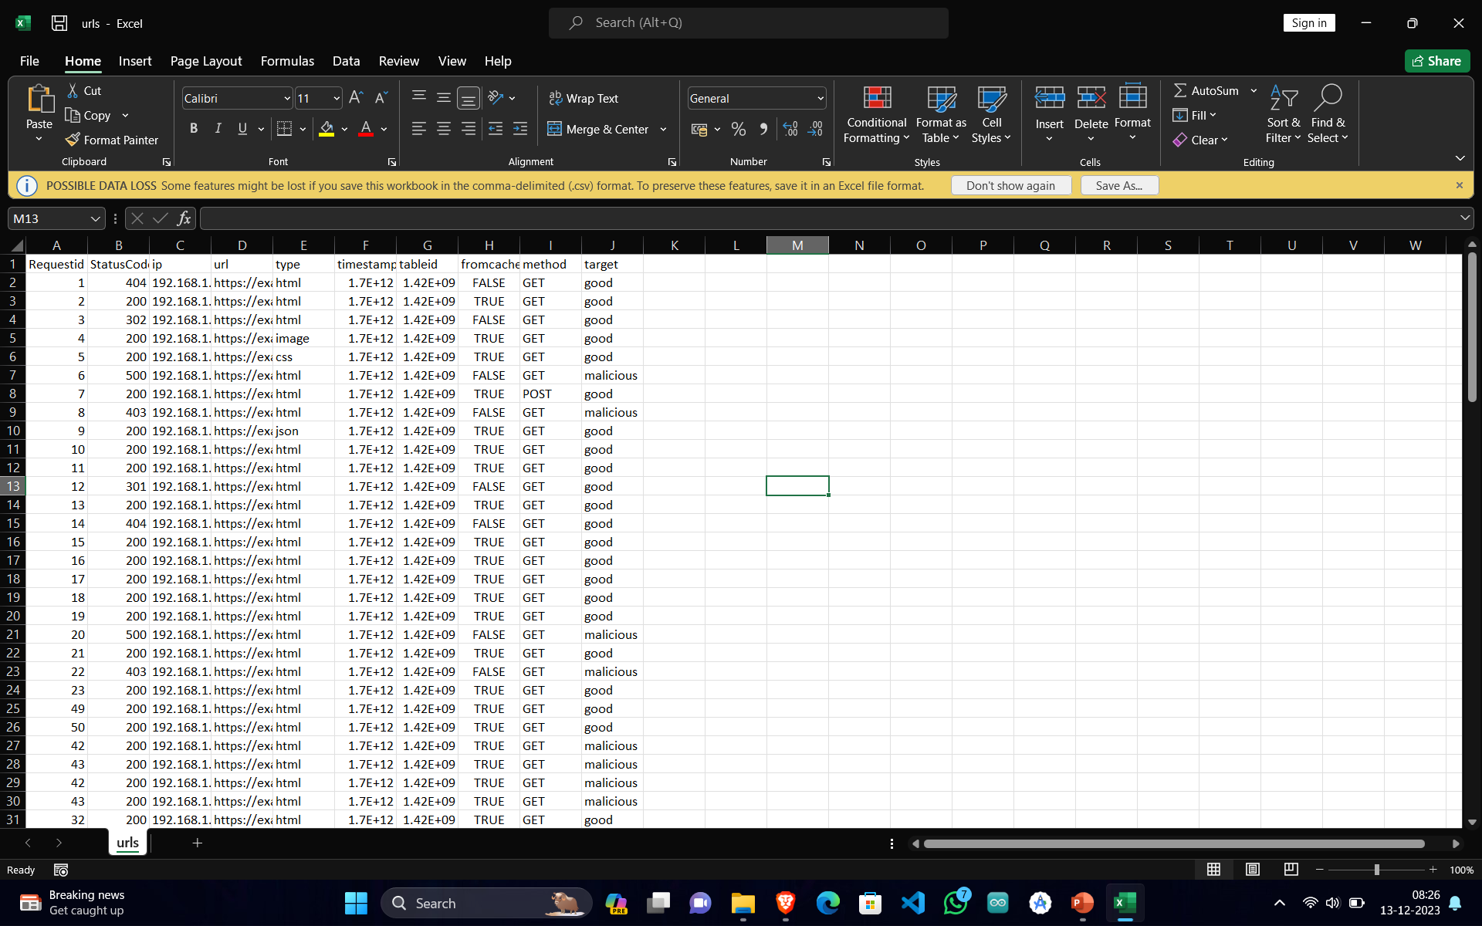
URL PARSER
FEATURES
URL Breakdown and classification on local Machine
Classified Messaging System for different level of threats.
Maintained Black and whitelists
Request Logs maintained in browser local storage for easy access.
Seamless integration with the local AI
TECHNOLOGY USED

Slide 11
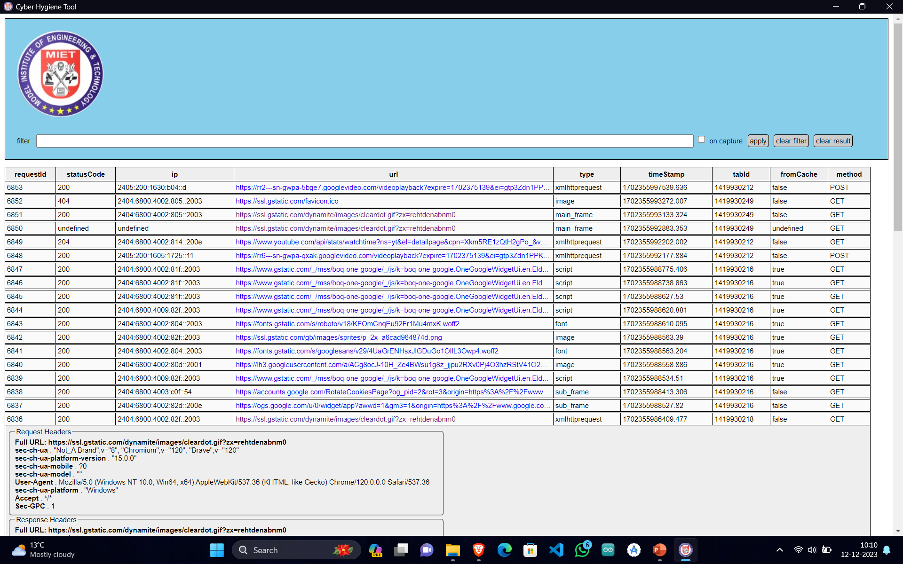
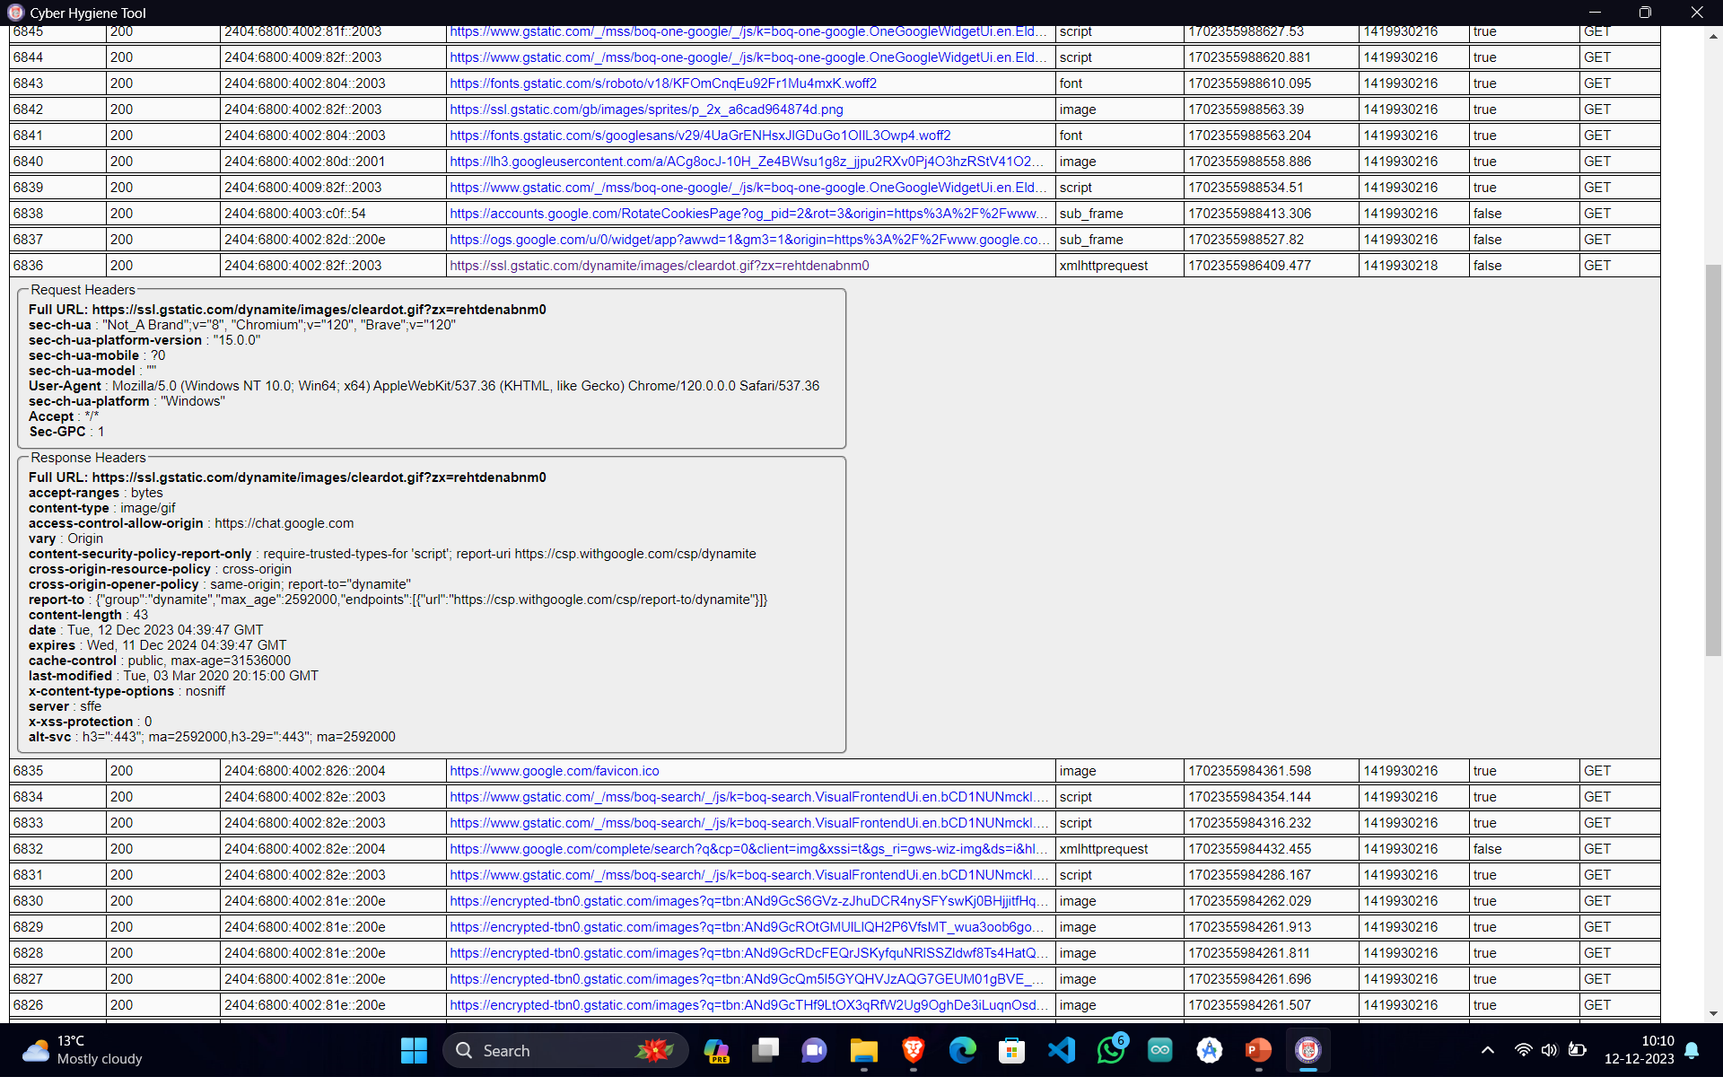
URL GUI TABLE

Slide 12
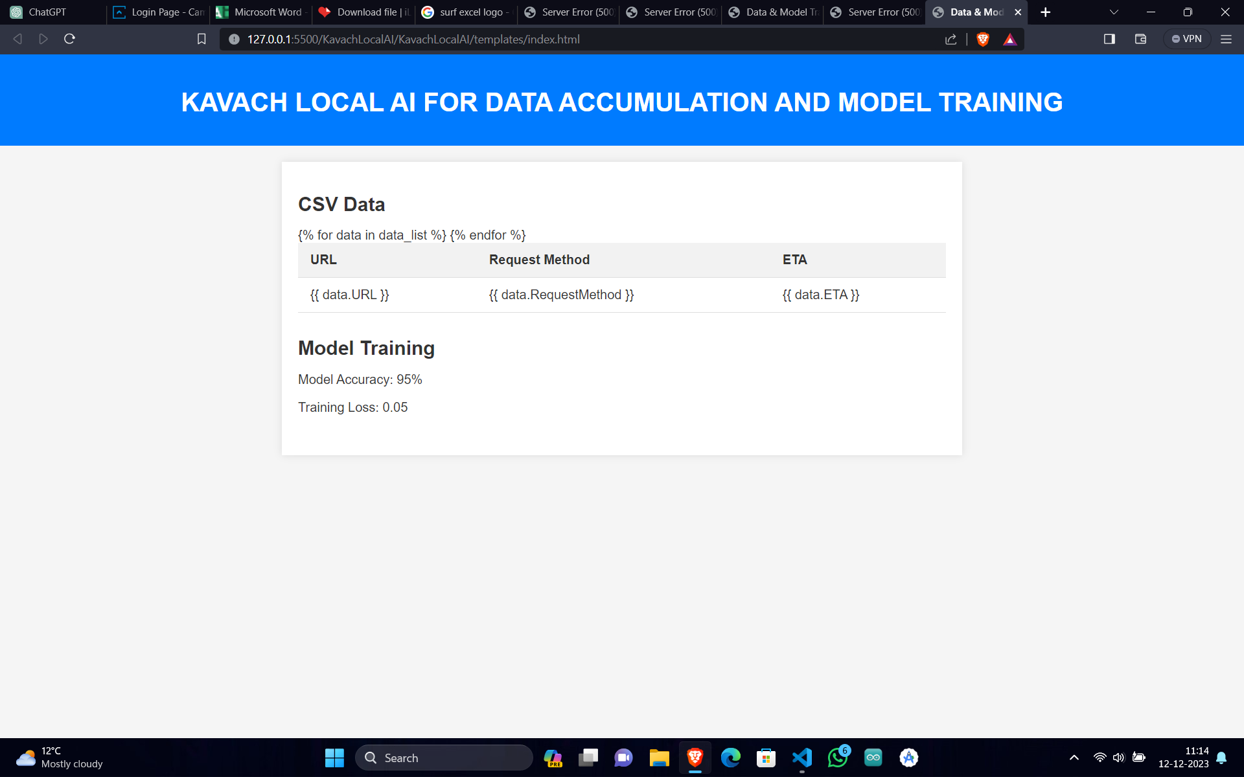
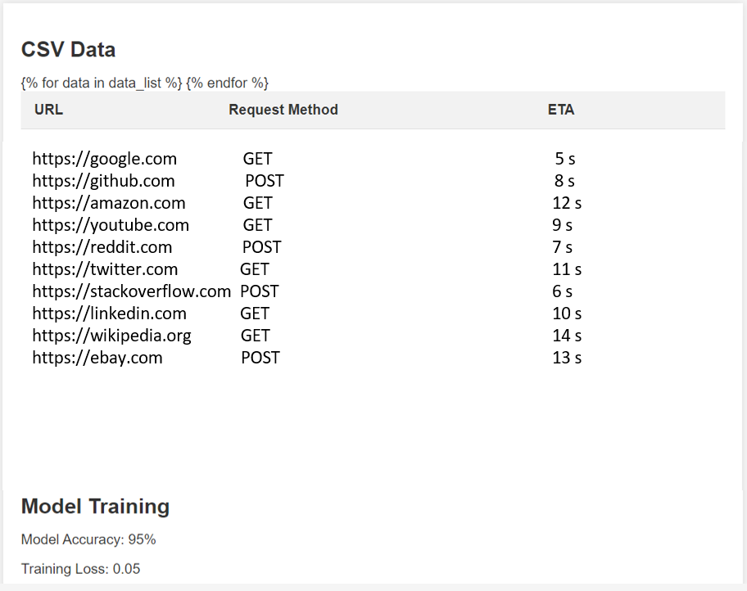
LOCAL AI MODEL
FEATURES
URL Breakdown and classification on local Machine
Threat based Incident response to the Global AI
Predictions based on more than 12 Independent variables and 1 target value.
Predictions based on best of the 2 AI prediction models (Linear Regression and Random Forest)
No data is sent out just the trained models and exfiltrated.
TECHNOLOGY USED

Slide 13
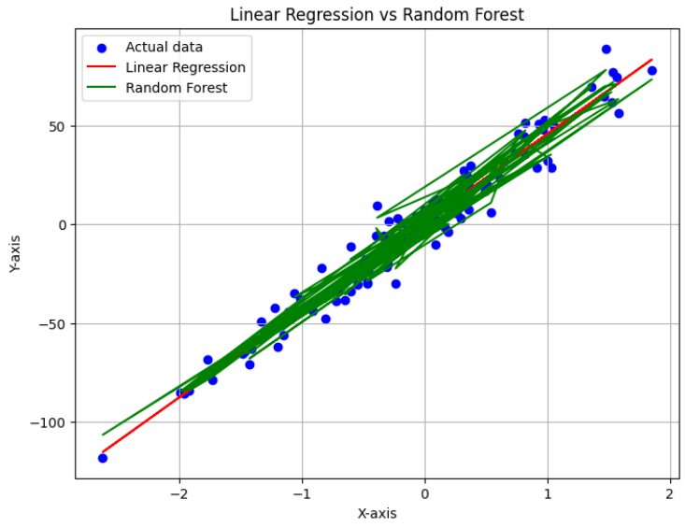
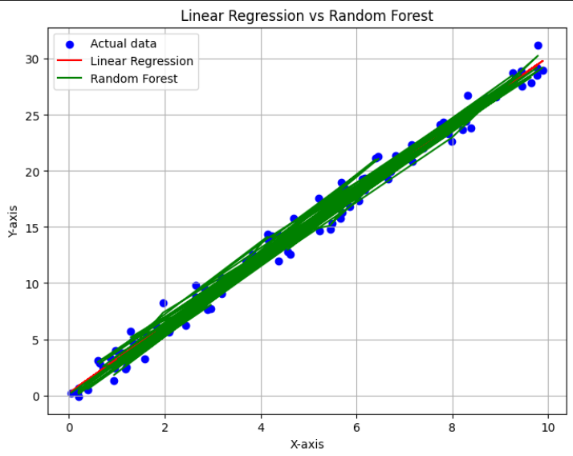
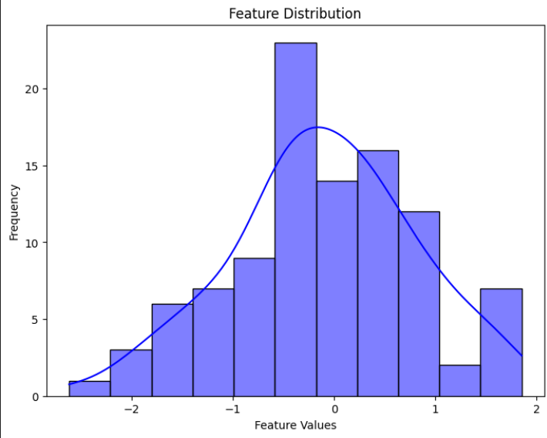
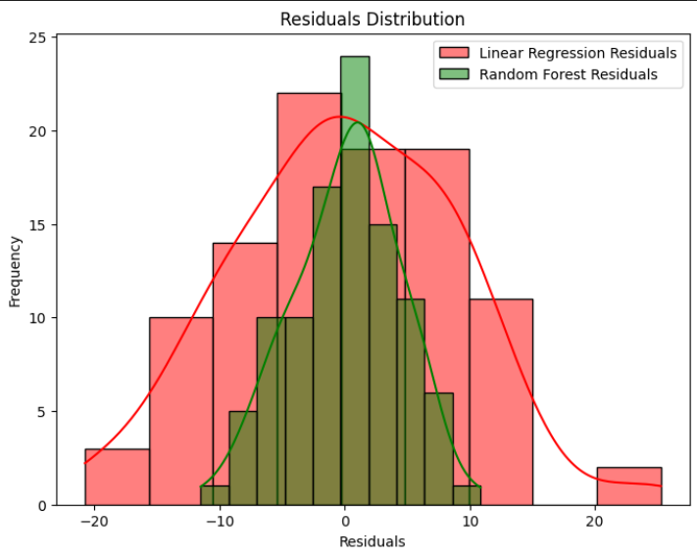
Traction

Slide 14
Target Market
General Public
Government Agencies
Companies / Enterprises
Large Scale Industries
Small scale Industries

Slide 15
DEMONSTRATION

Slide 16
Step 1
Increased Use of AI and Machine Learning
Future Roadmap
Step 2
Integration with Cloud- Based Security
Step 3
Windows Supported Web Browser
Step 4
Embedded Browser AI Functionality

Slide 17
QUESTIONS ?

Slide 18
THANK YOU

